Slide 1
U.S. Midterm Elections 2026
OMAR bruce
3/15/2026
Data101
Project #1

Slide 2
Will Republicans or Democrats control Congress? Why does it matter?
The 2026 midterm elections will have huge implications for the United States government.
A majority in the House of Representatives for the Democrats would give them leverage over the budget and likely kick off a number of investigations into Trump and his people.
A Senate majority for Democrats would make it more difficult for the Trump Administration to confirm appointees and pass legislation.
A majority in both branches of Congress could effectively render Donald Trump a lame duck President with two years left of his final term.

Slide 3
What is the appropriate dataset?
The number one predictor of midterm elections has proven to be the Generic Congressional Ballot. This survey asks participants, “If the midterm elections were being held today, which party would you vote for in Congress?”
For this analysis I chose an aggregation of over 300 Generic Congressional Ballot polls conducted since the second election of Donald Trump.
The source is natesilver.net, a well-respected poll analysis blog from Nate Silver, founder of the once famous FiveThirtyEight blog.
The individual polls come from a collection of the most recognized pollsters in the country, including The Washington Post, New York Times, Ipsos, Gallup, CNN, and Fox News.

Slide 4
pollster | startdate | enddate | adjusted_dem | adjusted_rep | adjusted_net | poll_id
Emerson College | 2/21/2026 | 2/22/2026 | 51.45721 | 43.22903 | 8.22818 | 901139
Hart Research Associates/Public Opinion Strategies | 2/27/2026 | 3/3/2026 | 48.59388 | 42.792 | 5.80188 | 901183
Cygnal | 2/24/2026 | 2/26/2026 | 47.66132 | 42.51203 | 5.149288 | 901177
Echelon Insights | 2/19/2026 | 2/23/2026 | 49.32269 | 43.64447 | 5.678219 | 901127
TIPP Insights | 1/27/2026 | 1/29/2026 | 45.67573 | 42.1384 | 3.537331 | 901111
The New York Times/Siena College | 1/12/2026 | 1/17/2026 | 47.69293 | 42.48041 | 5.212517 | 901038
Cygnal | 2/3/2026 | 2/4/2026 | 46.95755 | 42.5158 | 4.44175 | 901099
Marquette University Law School | 1/21/2026 | 1/28/2026 | 50.25196 | 44.32963 | 5.922329 | 901078
Beacon Research/Shaw & Company Research | 1/23/2026 | 1/26/2026 | 50.6918 | 45.64906 | 5.04274 | 901058
John Zogby Strategies | 2/4/2026 | 2/5/2026 | 47.15905 | 41.56263 | 5.59642 | 901087

Slide 5
Data analysis – approach and methods
Two main approaches were used
What is the trend of polls over the last fifteen months?
Which party is leading in the polls currently?
To capture the trend of the polls, the net approval ratings were plotted over time.
Net approval is the negative or positive ratings for Democrats compared to Republicans.
To capture a current snapshot, approval ratings for Democrats and Republicans were plotted since February 1, 2026.
To summarize the findings a table shows net approval of the earliest 25 polls vs the most recent 25.

Slide 6
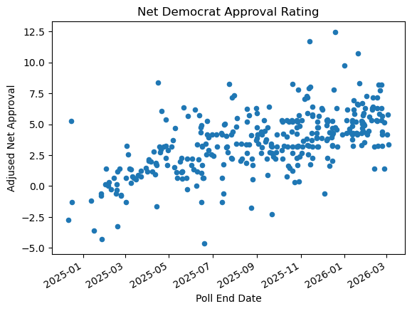
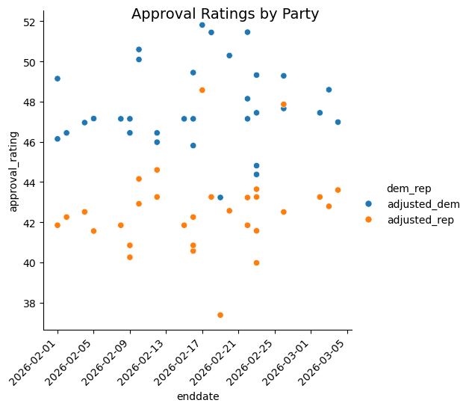
Data visualization – trend and snapshot

Slide 7
Discussion of findings
Major Takeaway – Democrats are currently leading the polls and are trending upwards since 2025.
The trend of net approval ratings shows a steady increase in ratings for the Democrats since the start of Donald Trump’s second term.
The snapshot of February and March 2026 shows a clear lead, with nearly all polls reflecting higher ratings for Democrats.
 | Oldest 25 Polls | Newest 25 Polls | Net Change
Democrats | 44.45 | 47.45 | 3.00
Republican | 44.82 | 42.79 | (2.03)
Net | (0.38) | 4.65 | 5.03

Slide 8
What comes next?
It is too early to pick a winner – polls can shift dramatically as voters change their minds.
What will be the effects of the Iran war and the resulting rise in prices?
Wars can be very polarizing on public opinion.
There are two other factors used in predicting midterm winners:
Ideological shifts in public opinion
Presidential approval ratings

